Slide 1
Host Country Tax Administration (HCTA) International Data Exchange Service (IDES) Onboarding Instructions
9 July, 2014
Draft

Slide 2
Purpose
This briefing provides detailed instructions for Host Country Tax Administration (HCTA) onboarding, which is the process of establishing and activating an IDES account for an HCTA
HCTA must have previously signed an InterGovernmental Agreement (IGA) with the Residence Country Tax Administration (RCTA)
Main onboarding steps include:
Identifying and verifying the identity of the first HCTA user (the “Superuser” (SU))
Publishing the HCTA digital certificate to the IDES user directory
Establishing additional “regular” users within the HCTA group
Allowing the HCTA-SU to prepare and upload a test file to IDES before activating the account

Slide 3
Actors and Definitions
HCTA - Host Country Tax Administration
HCTA is the tax administration in a country where a citizen from another country has income. The HCTA will typically be sending the FATCA data to an RCTA
HCTA-AU – HCTA Authorized User
Authorized User representing the HCTA (e.g., CRA employee)
HCTA-CA – HCTA Competent Authority
Is the representative of the HCTA responsible for implementing tax treaties (in this case, FATCA & associated IGAs)
HCTA-SU – HCTA Superuser
User authorized by the HCTA (e.g., CRA employee). The SU has privileges to create additional authorized IDES users under the superuser’s group.
IDES Vendor – International Data Exchange Service Vendor
The Vendor responsible for operating the International Data Exchange Service

Slide 4
Actors and Definitions (con’t.)
IGA – Inter-Governmental Agreement, currently one of either
Model 1 IGA – FFIs report to their HCTA which reports to IRS
HCTA-CA identified in the IGA will receive a letter from the IDES Vendor to which a response must be made prior to Onboarding being possible
Model 2 IGA – FFIs report directly to IRS
RCTA – Residence Country Tax Administration

Slide 5
Prerequisites
The HCTA has signed a Model 1 IGA with the RCTA, in this case, the IRS
HCTA-CA has completed IDES Registration:
After the IDES vendor received the IGA, they will have sent a letter to the HCTA-CA asking the HCTA to identify the HCTA-SU
HCTA-CA has completed instructions in the letter to retrieve the IDES digital certificate
HCTA-CA has validated the IDES digital certificate to the root CA certificate
HCTA-CA has sent a signed encrypted email to the IDES Account Manager email address specified in the letter, and provided
HCTA-SU name, email address, phone number
HCTA public key
The IDES Vendor has configured IDES based on the above
The HCTA-SU has received an email from IDES which:
Confirms HCTA-SU username
Provides temporary password seed (User Token Seed)
Provides link to account activation page

Slide 6
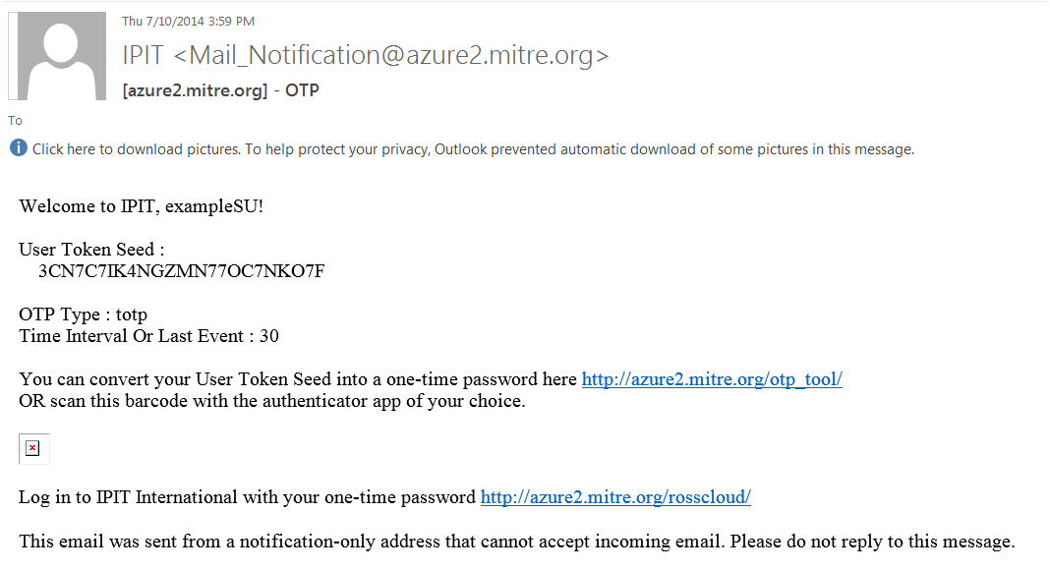
HCTA Onboarding – HCTA-SU Receives IDES Email
HCTA-SU decrypts the email from the IDES Vendor
HCTA-SU verifies the IDES digital signature using the IDES public key

Slide 7
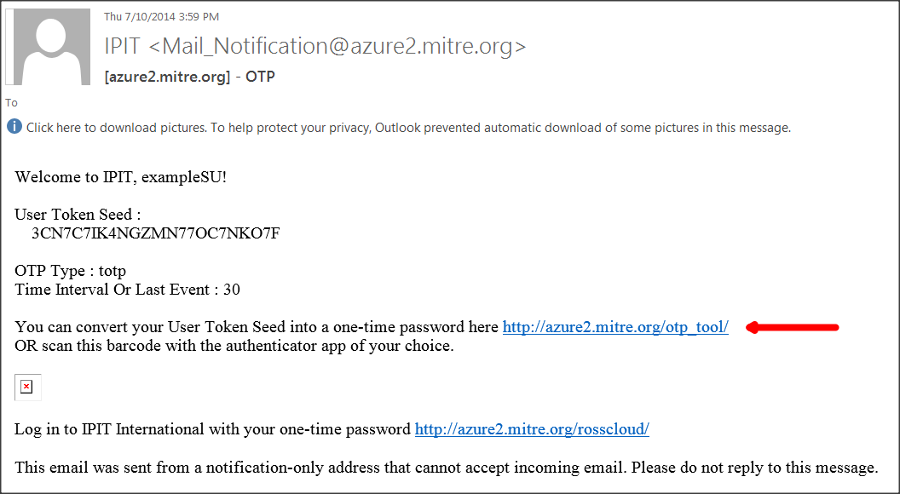
HCTA Onboarding – HCTA-SU Creates One-time Password
HCTA-SU copies User Token Seed
HCTA-SU clicks on link indicated by red arrow

Slide 8
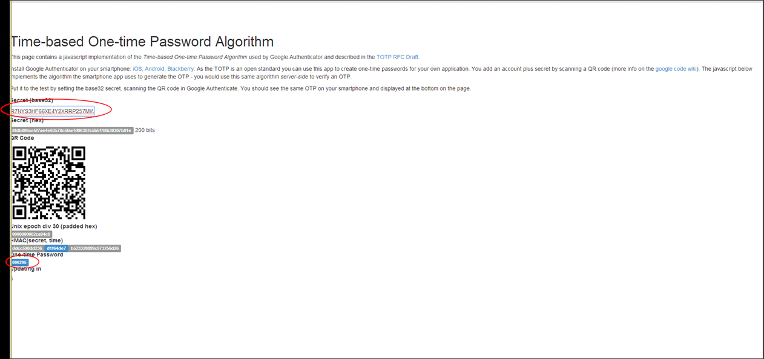
HCTA Onboarding – HCTA-SU Creates One-time Password
HCTA-SU pastes User Token Seed into box circled in red
One-time password (OTP) appears in lower area circled in red

Slide 9
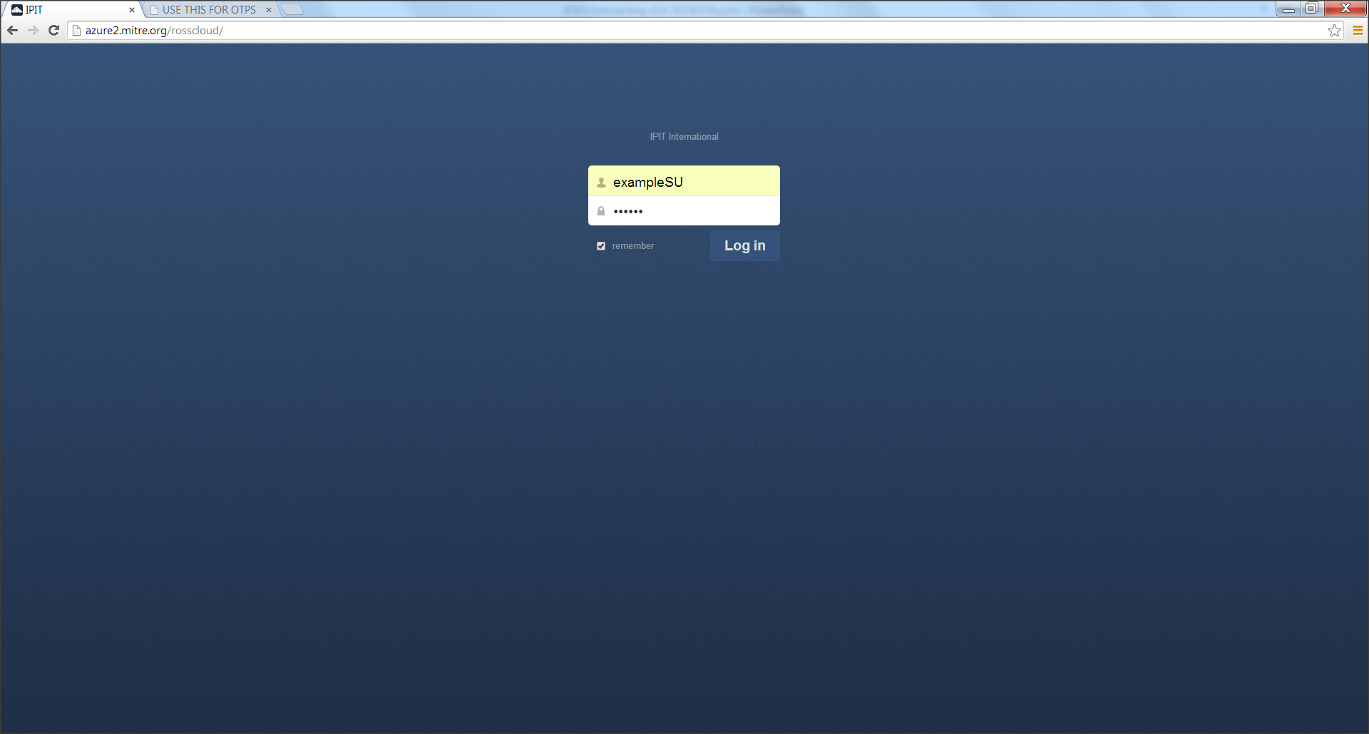
HCTA Onboarding – HTCA-SU IDES Initial Login
HCTA-SU browser is Chrome, Firefox, or Internet Explorer
HCTA-SU clicks the account activation link provided in the email
Browser is directed to URL address ipit.international
HCTA-SU logs into IDES with the provided username and OTP generated in previous step

Slide 10
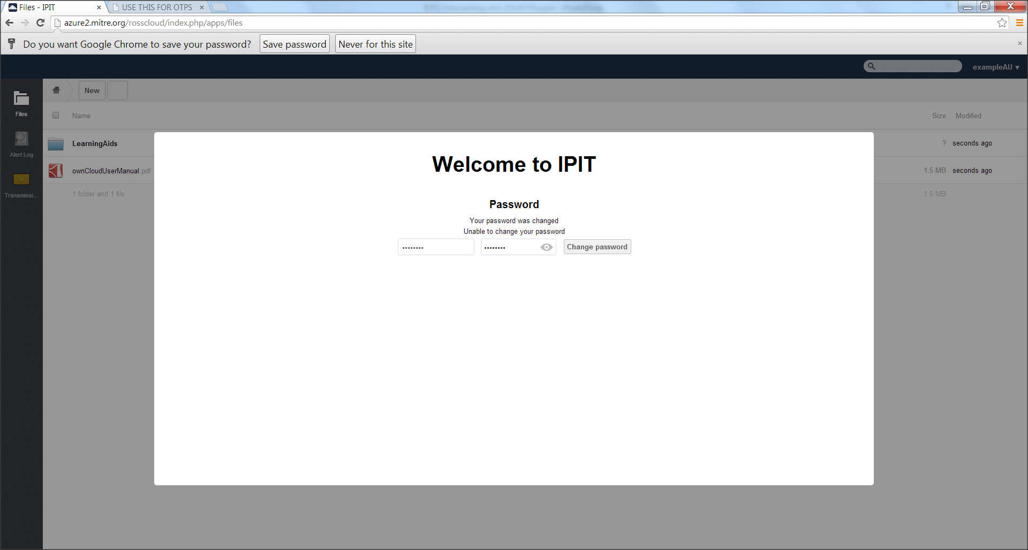
HCTA Onboarding – HTCA-SU IDES Initial Login
HCTA-SU is prompted to create a new password
HCTA-SU enters a password and clicks on the change password button

Slide 11
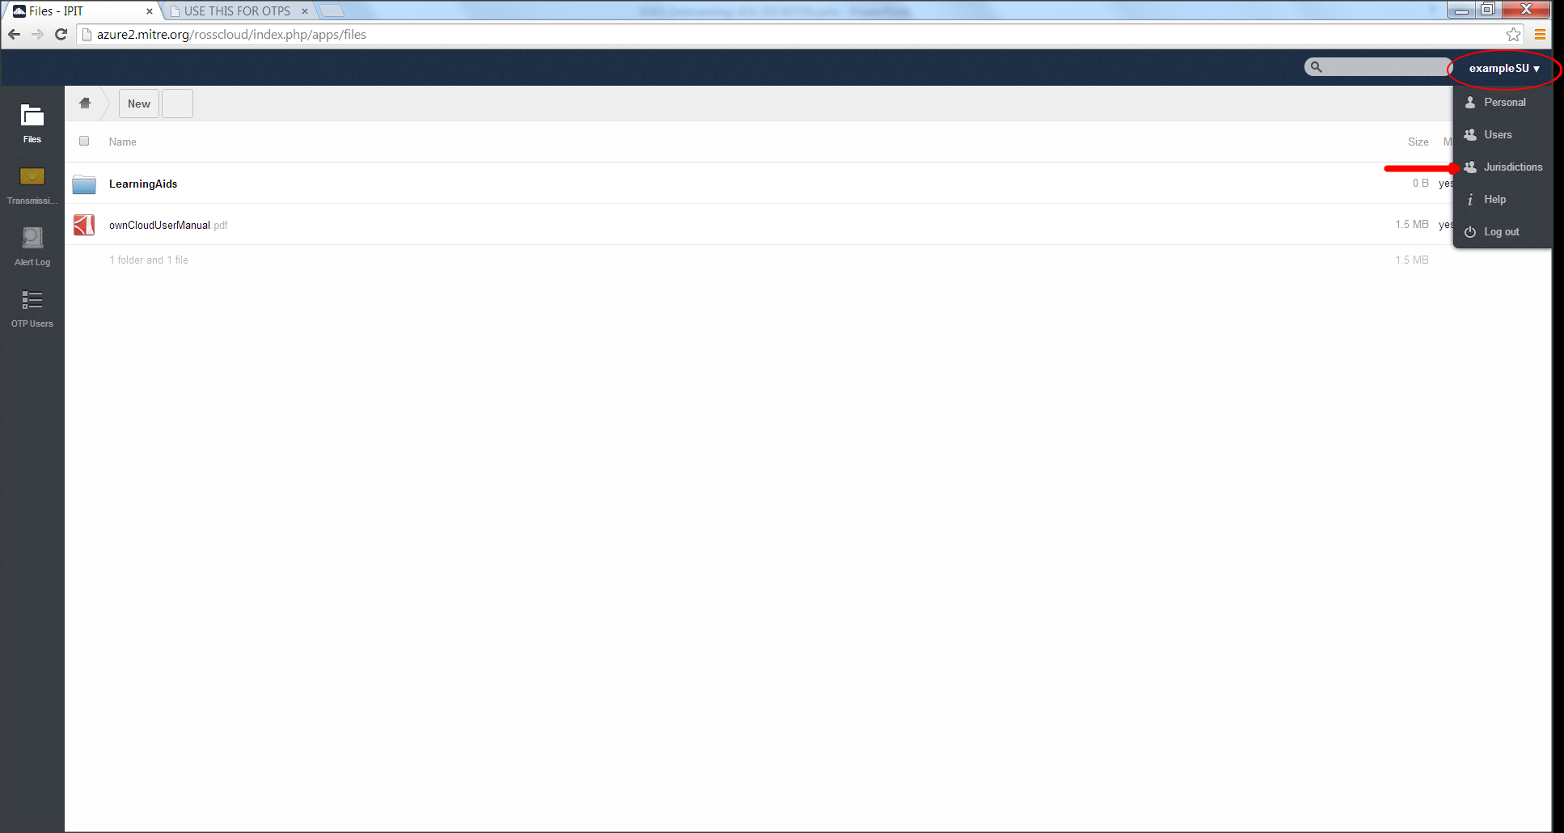
HCTA Onboarding – HTCA-SU IDES Initial Login
HCTA-SU navigates to Jurisdiction Screen to enter Public Key
Click on username, then select “Jurisdiction”

Slide 12
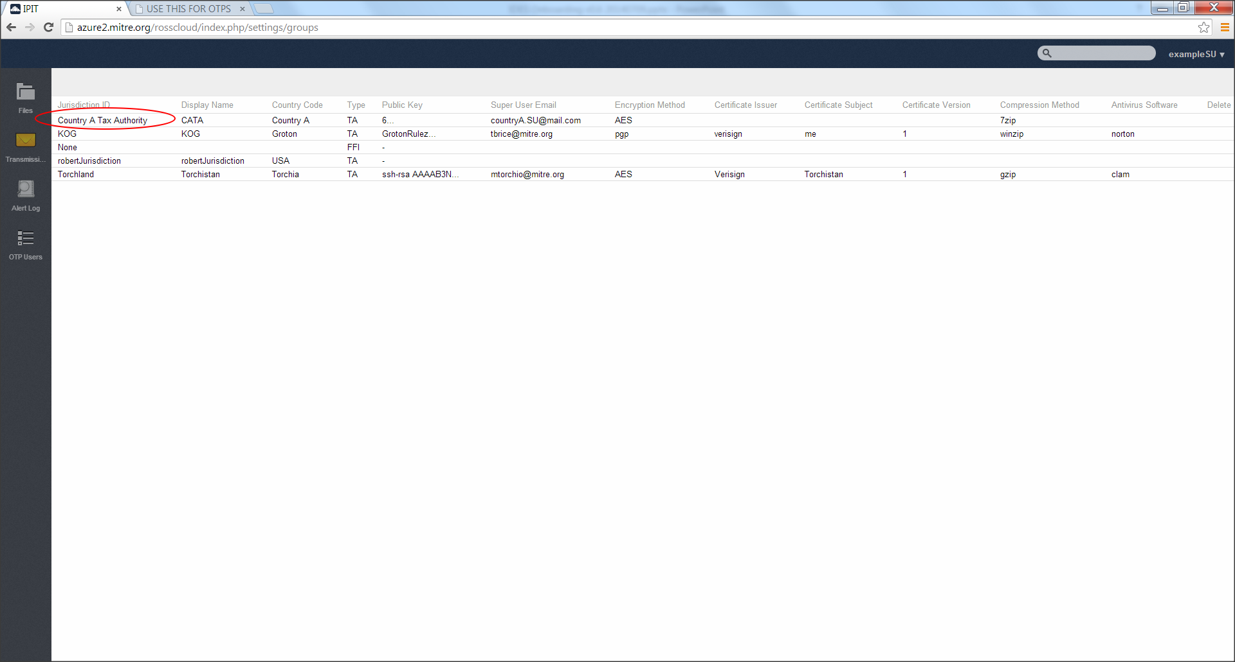
HCTA Onboarding – HTCA-SU IDES Initial Login
HCTA-SU selects their Jurisdiction

Slide 13
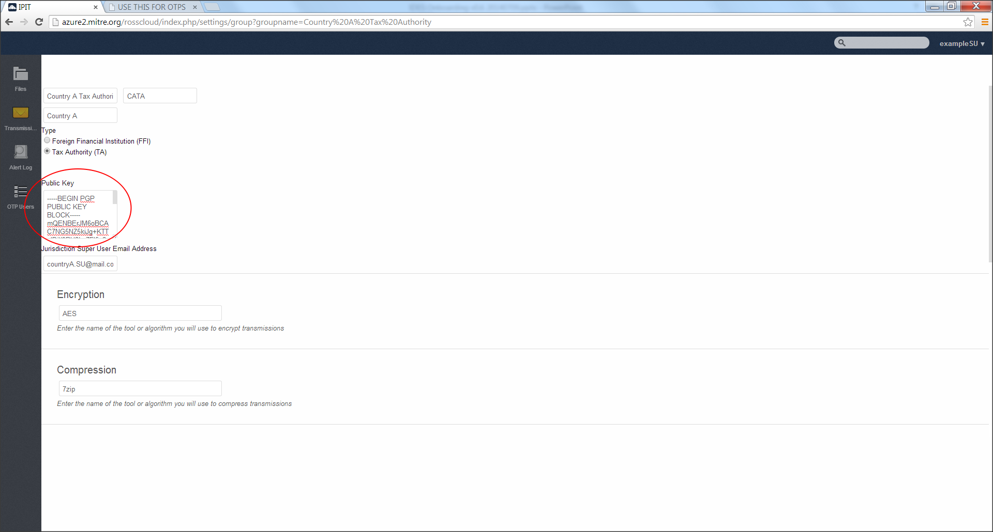
HCTA Onboarding – HTCA-SU IDES Initial Login
HCTA-SU pastes Public Key into field circled in red
HCTA-SU scrolls down and presses “Create”

Slide 14
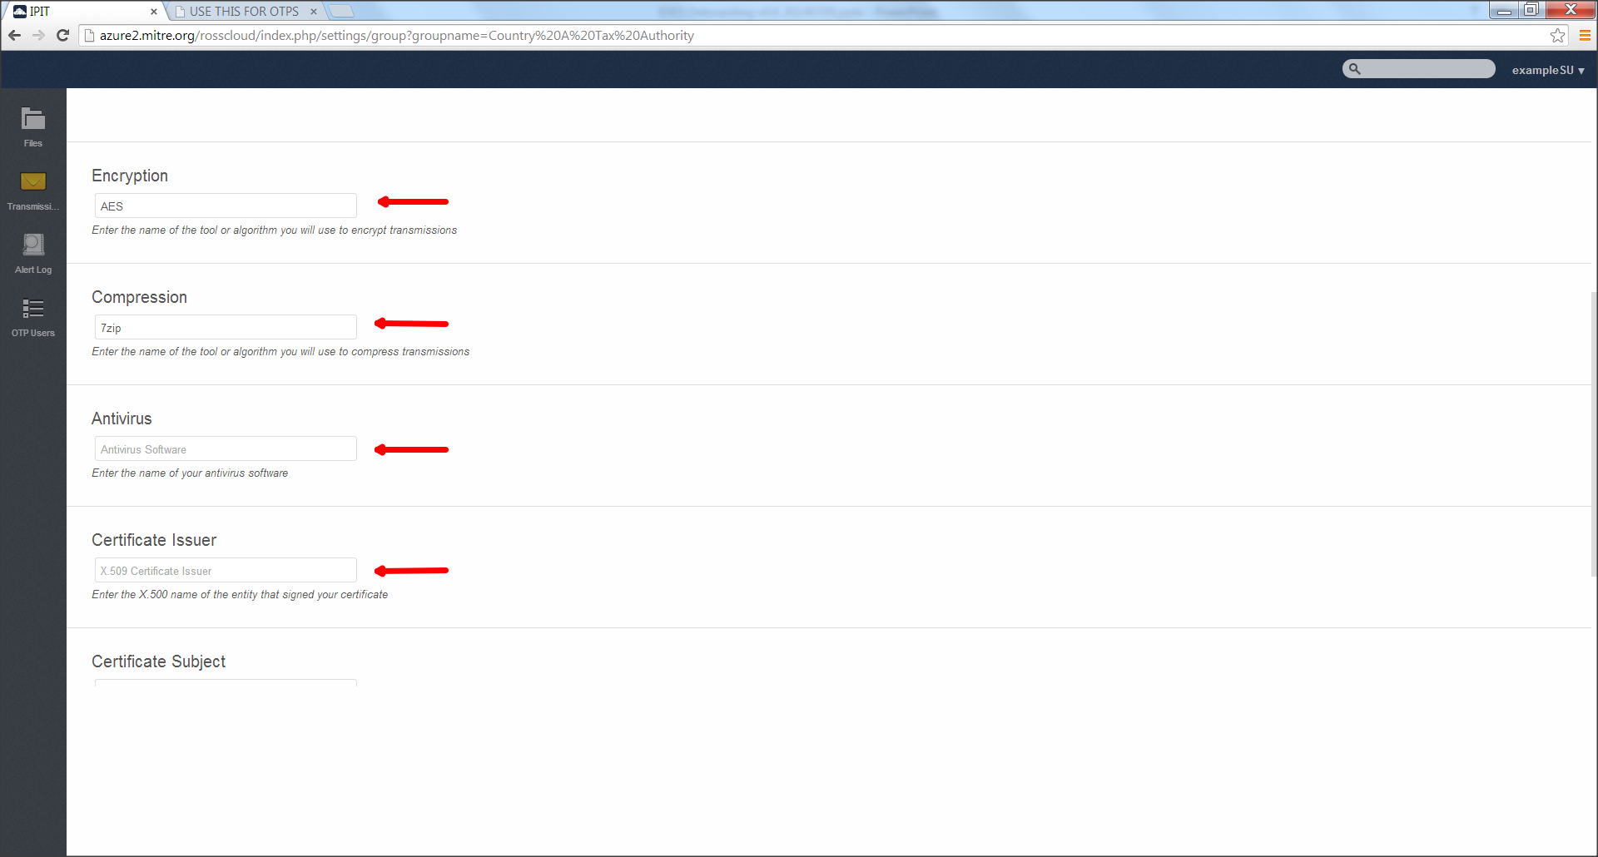
HCTA Onboarding – HTCA-SU IDES Initial Login
HCTA-SU provides technologies
Scroll down to provide those requested on next slide

Slide 15
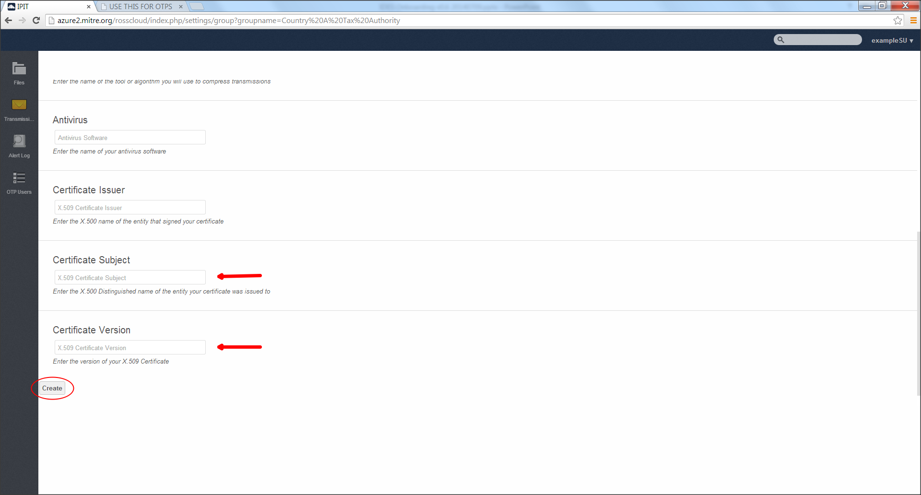
HCTA Onboarding – HTCA-SU IDES Initial Login
HCTA-SU provides technologies, then clicks “Create”

Slide 16
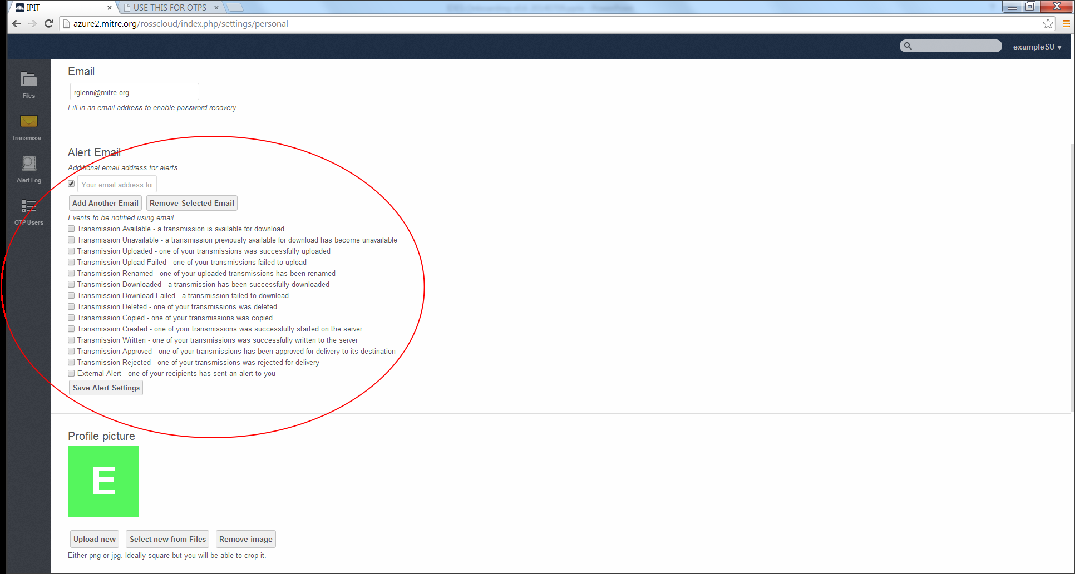
HCTA Onboarding – Configure Alerts
HCTA-SU clicks on display name in upper-right of browser, and selects “Personal” from the drop down menu
The Alerts portion of the “Personal” page is shown below
HCTA-SU configures Notifications and clicks “Save Alert Settings”

Slide 17
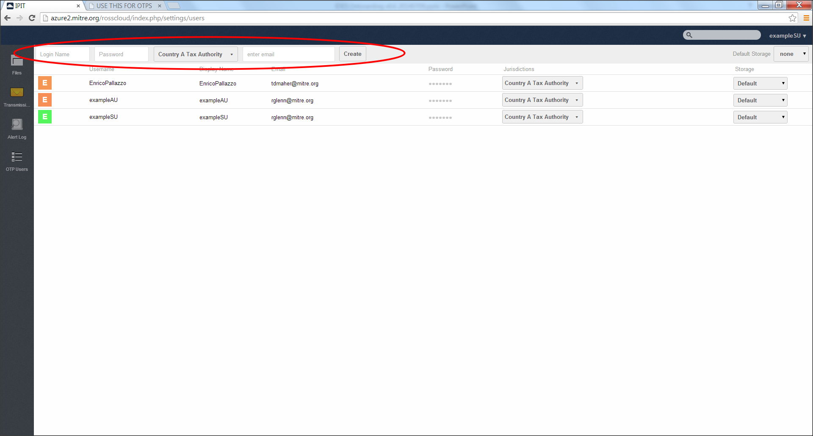
HCTA Onboarding – Add Authorized Users
HCTA-SU may now create non-superusers (HCTA-AUs)
Click on username in upper-right of browser, and select “Users”
HCTA-SU supplies Login Name, etc., in fields shown below
HCTA-SU clicks “Create” to create a new HCTA-AU

Slide 18
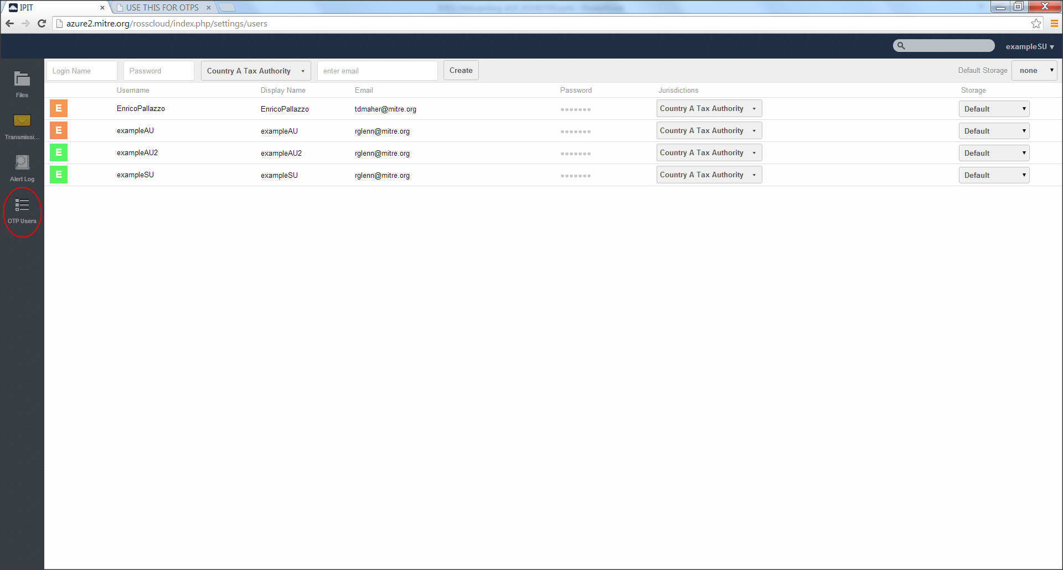
HCTA Onboarding – Add Authorized Users
HCTA-SU click on the OTP_Users button in the left side navigation bar to move on to the next step in creating an AU

Slide 19
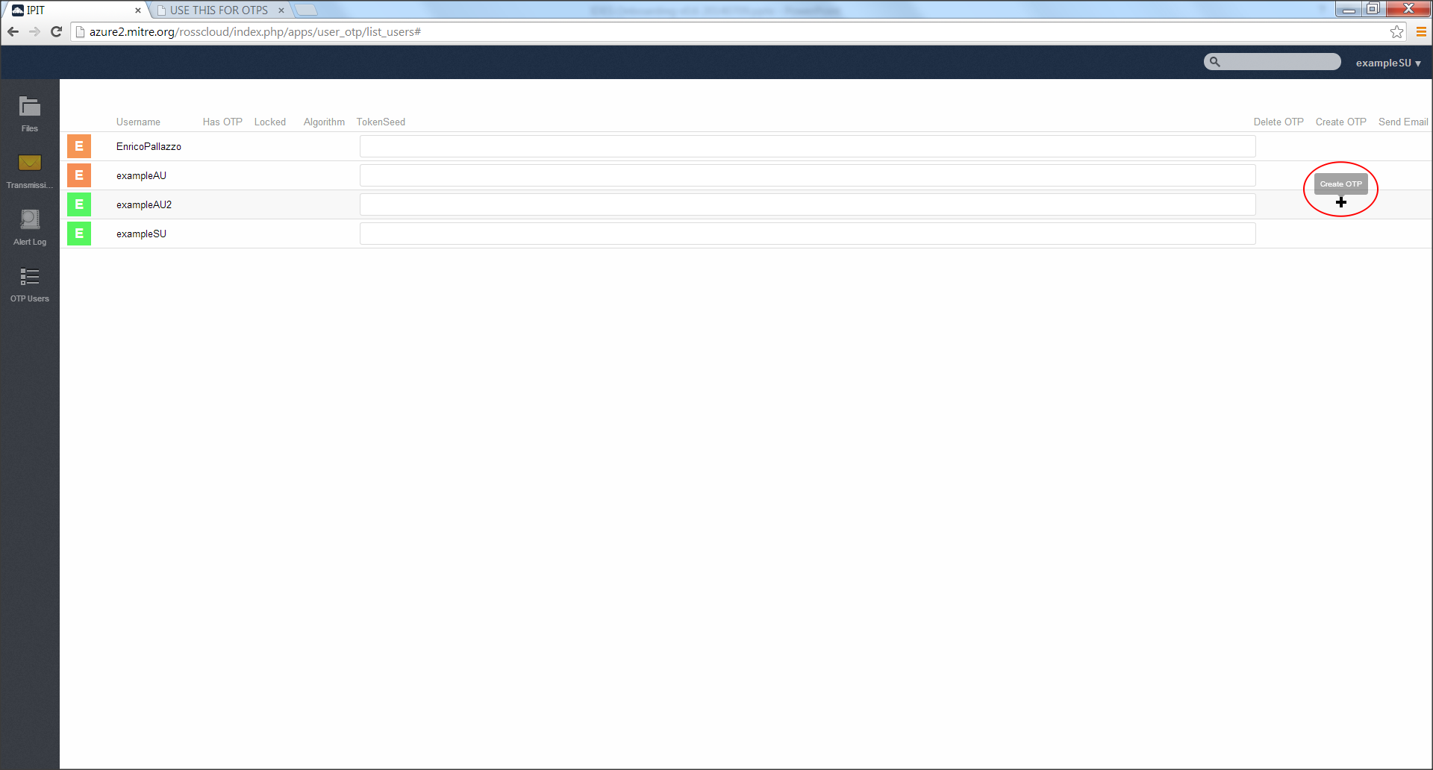
HCTA Onboarding – Add Authorized Users
HCTA-SU then mouses over the Create OTP column for an appropriate user. A plus sign will appear. Click this to generate the TokenSeed.

Slide 20
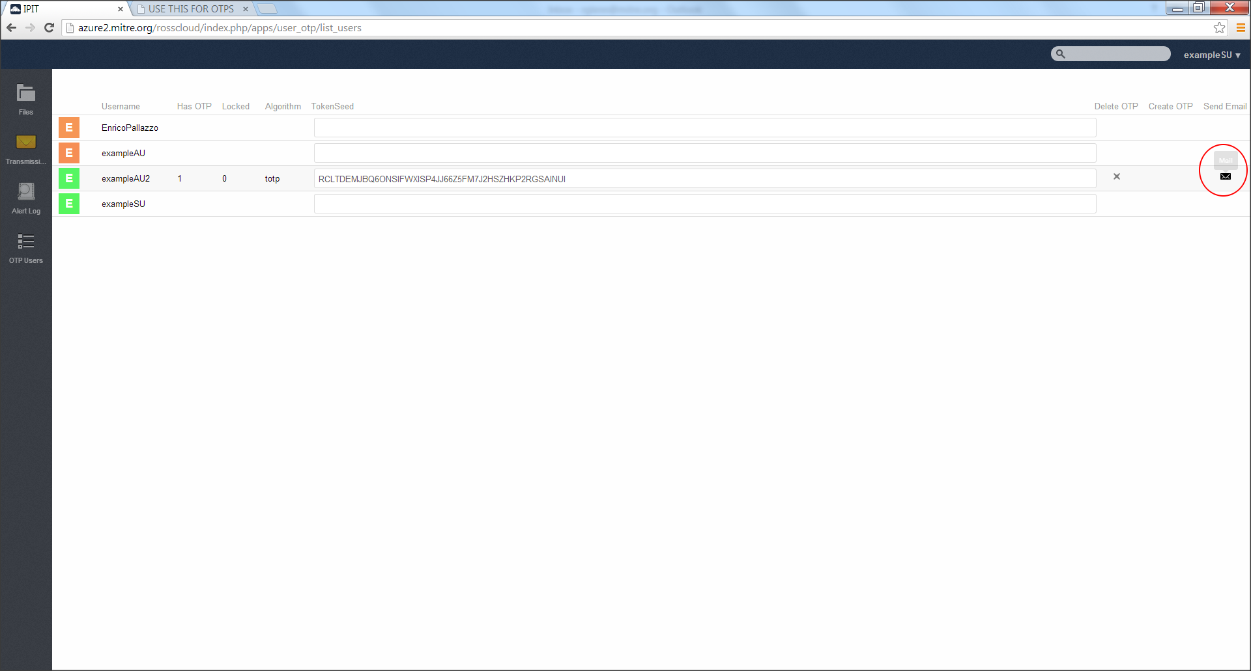
HCTA Onboarding – Add Authorized Users
HCTA-SU finalizes the creation of the user by mousing over the Send Email column. An email icon appears. Click this to send on an email to the AU. This email starts the AU account set-up process for an AU.

Slide 21
HCTA Onboarding – HCTA-AU Receives IDES Email
HCTA-AU decrypts the email from the IDES Vendor
HCTA-AU verifies the IDES digital signature using the IDES public key

Slide 22
HCTA Onboarding
BACKUP Slides

Slide 23
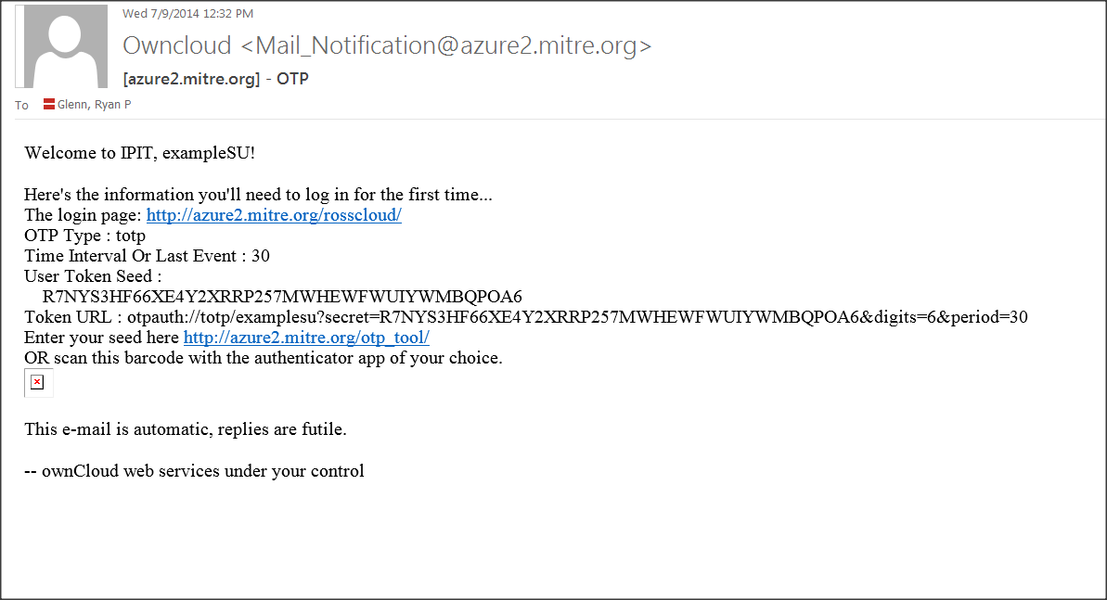
Step 20: example one time password email

Slide 24

Step 20: example one time password email

Slide 25
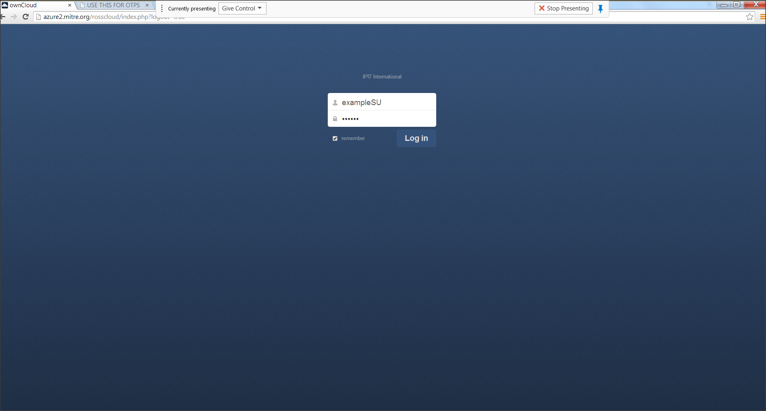
Step 20: Login with using the OTP Token

Slide 26
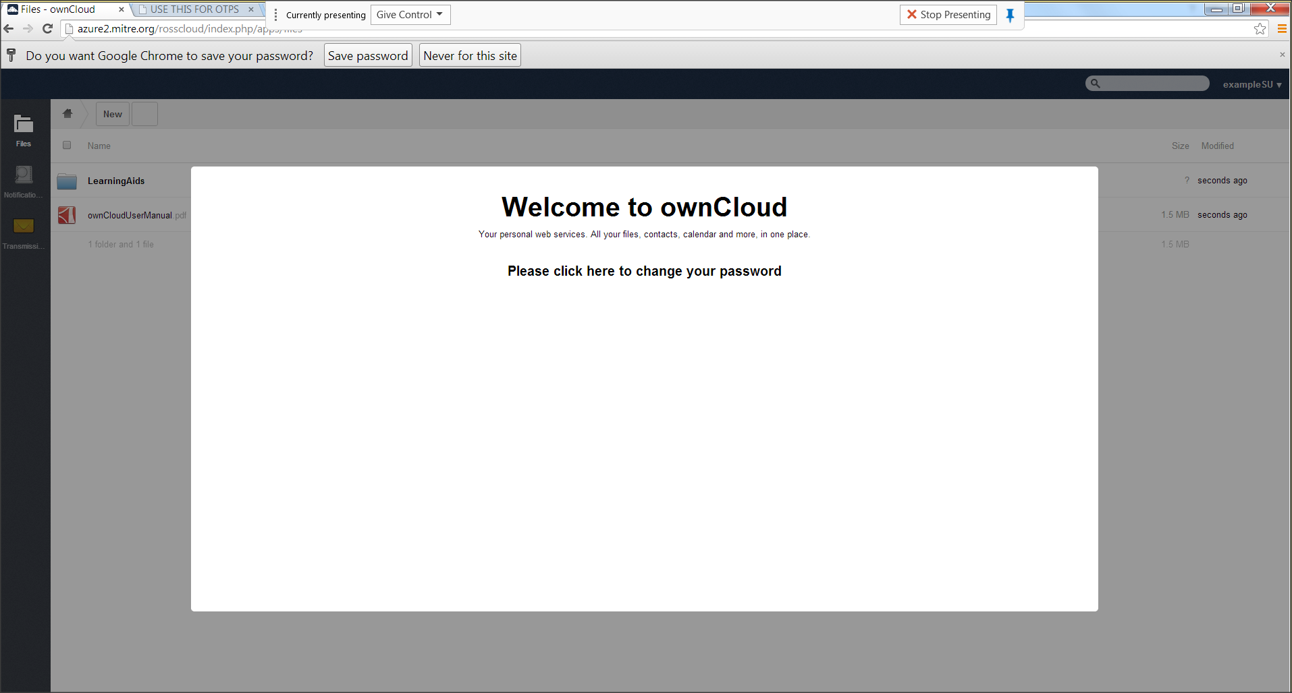
Step 21: Prompt for password change on first login

Slide 27
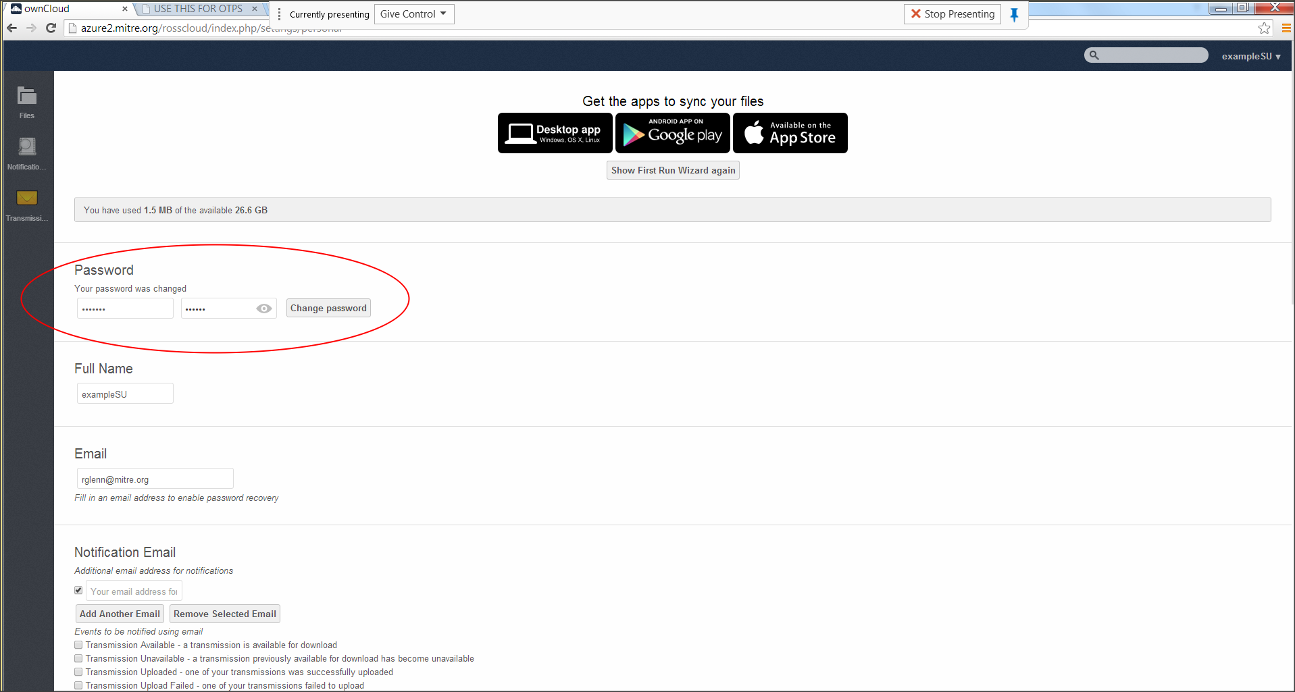
Step 21: Change Password on Initial login

Slide 28
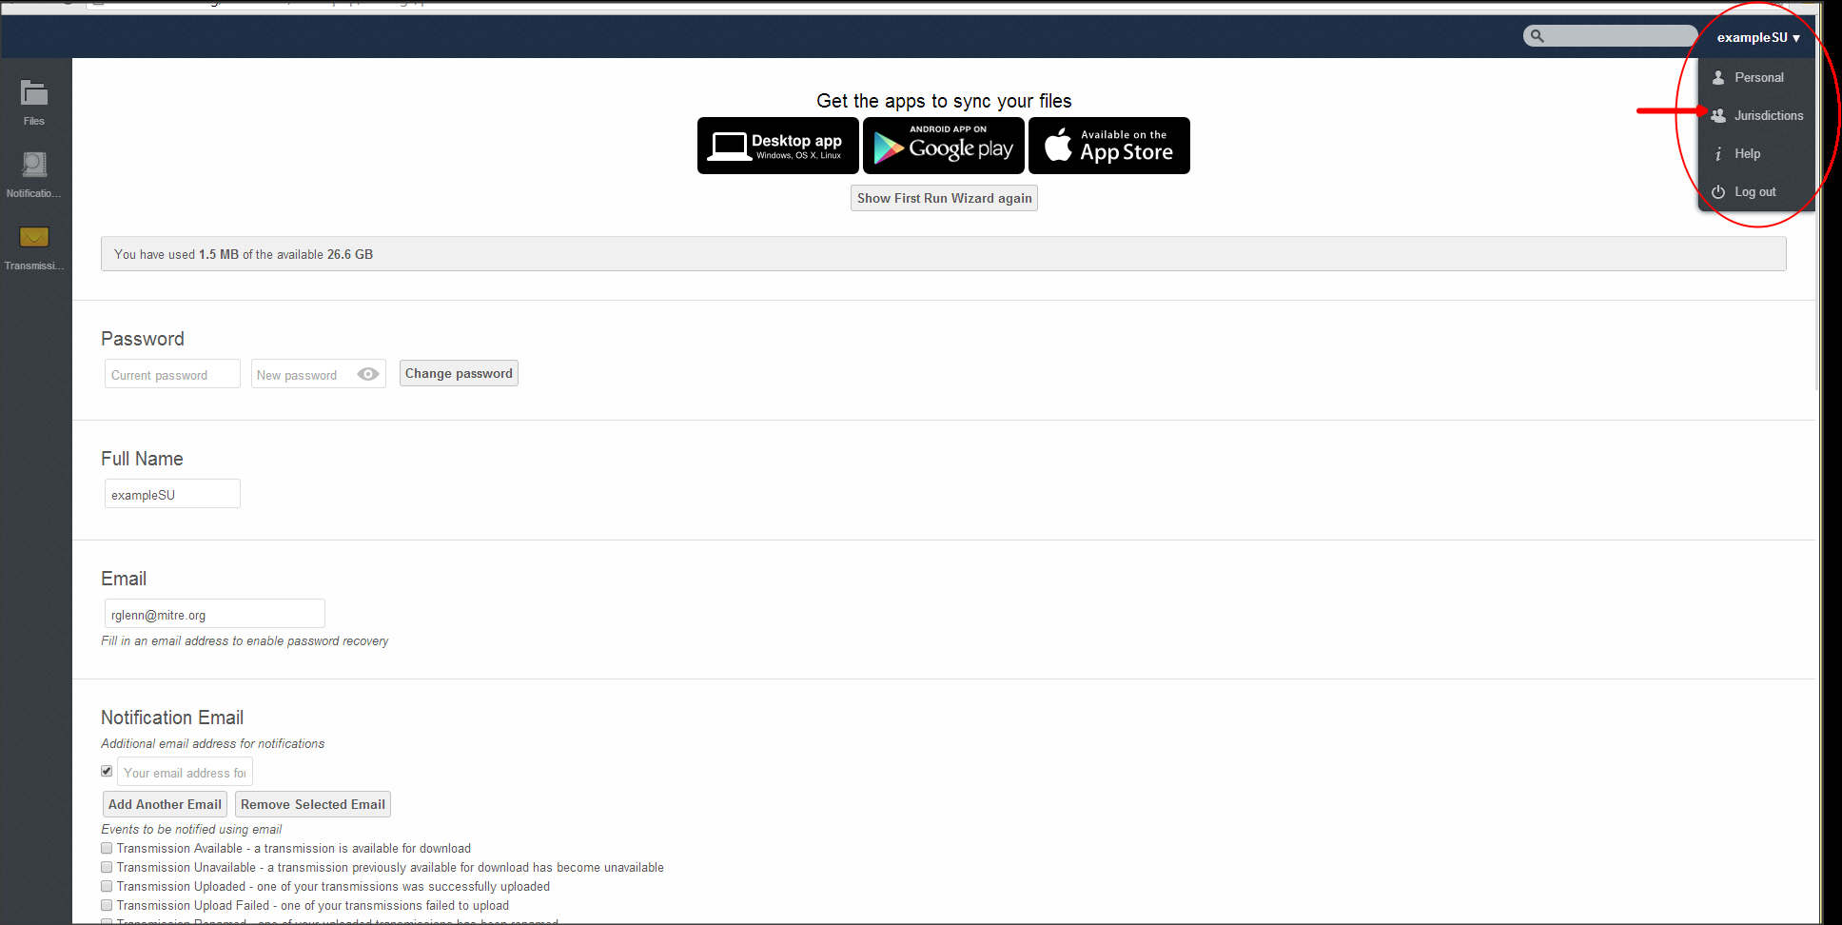
Step 26: Navigate to Jurisdiction Screen to enter Public Key

Slide 29
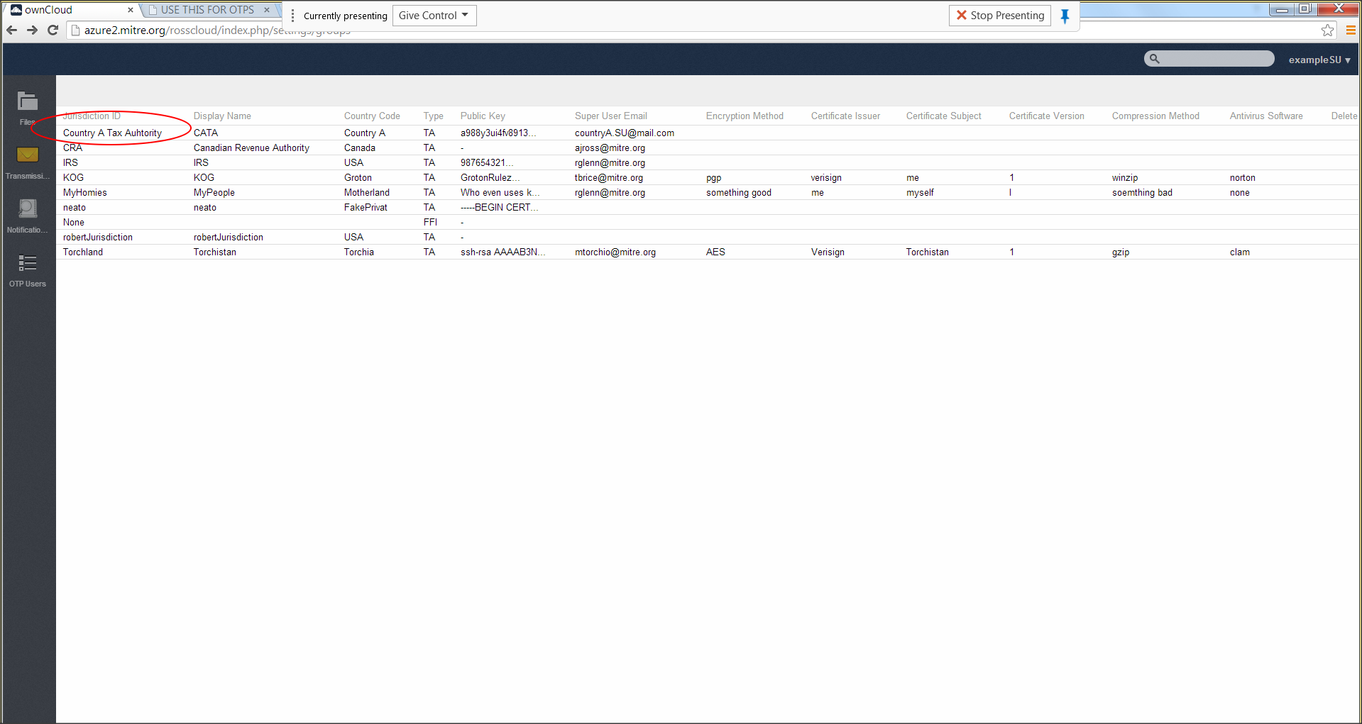
Step 26: Jurisdiction Screen

Slide 30
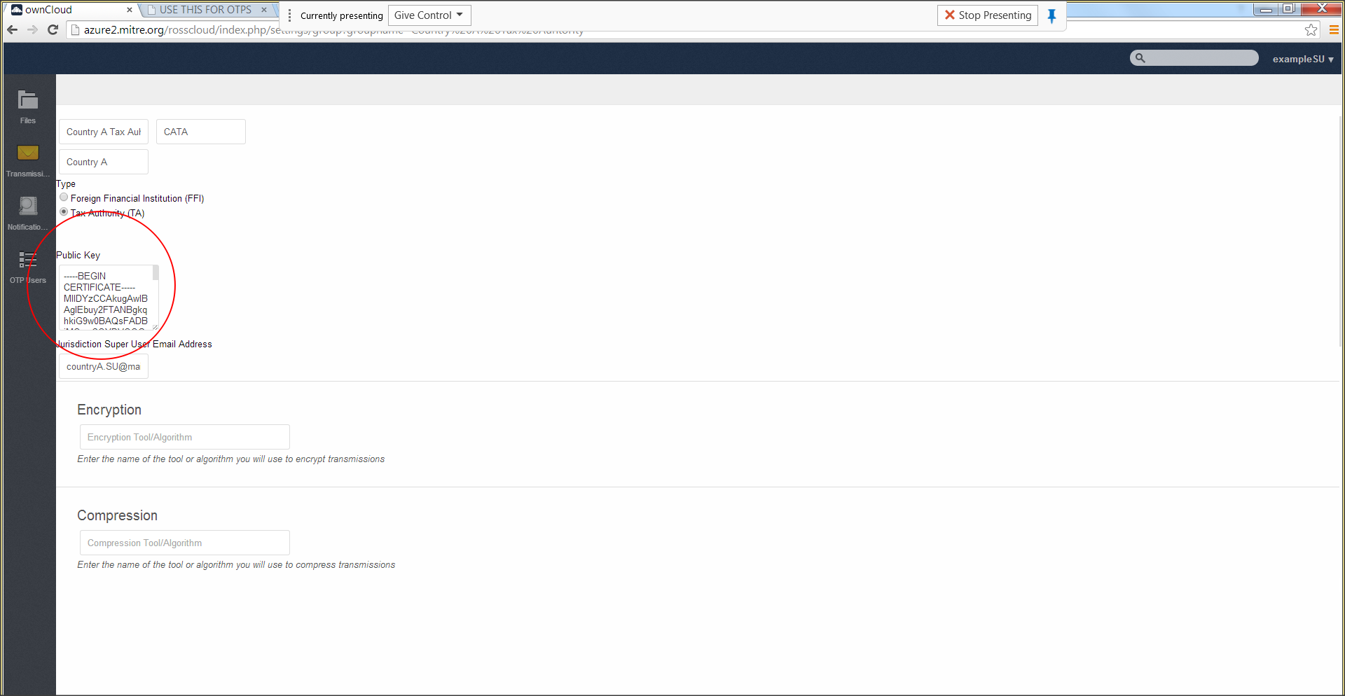
Step 26: Insert Public key into Field(scroll down and click create)

Slide 31
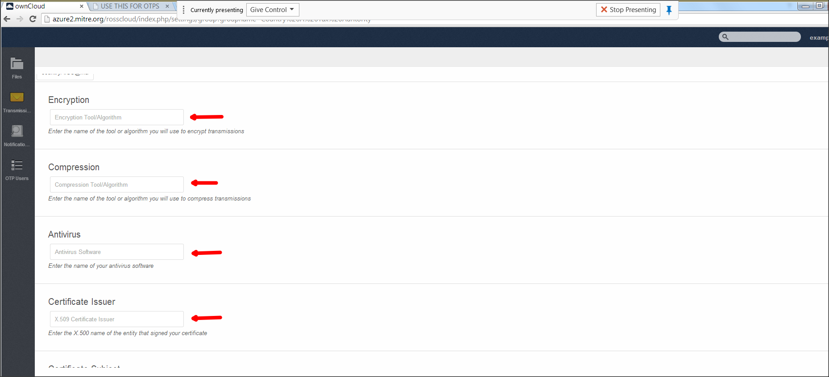
Step 27-28: Provide information on the HCTA

Slide 32
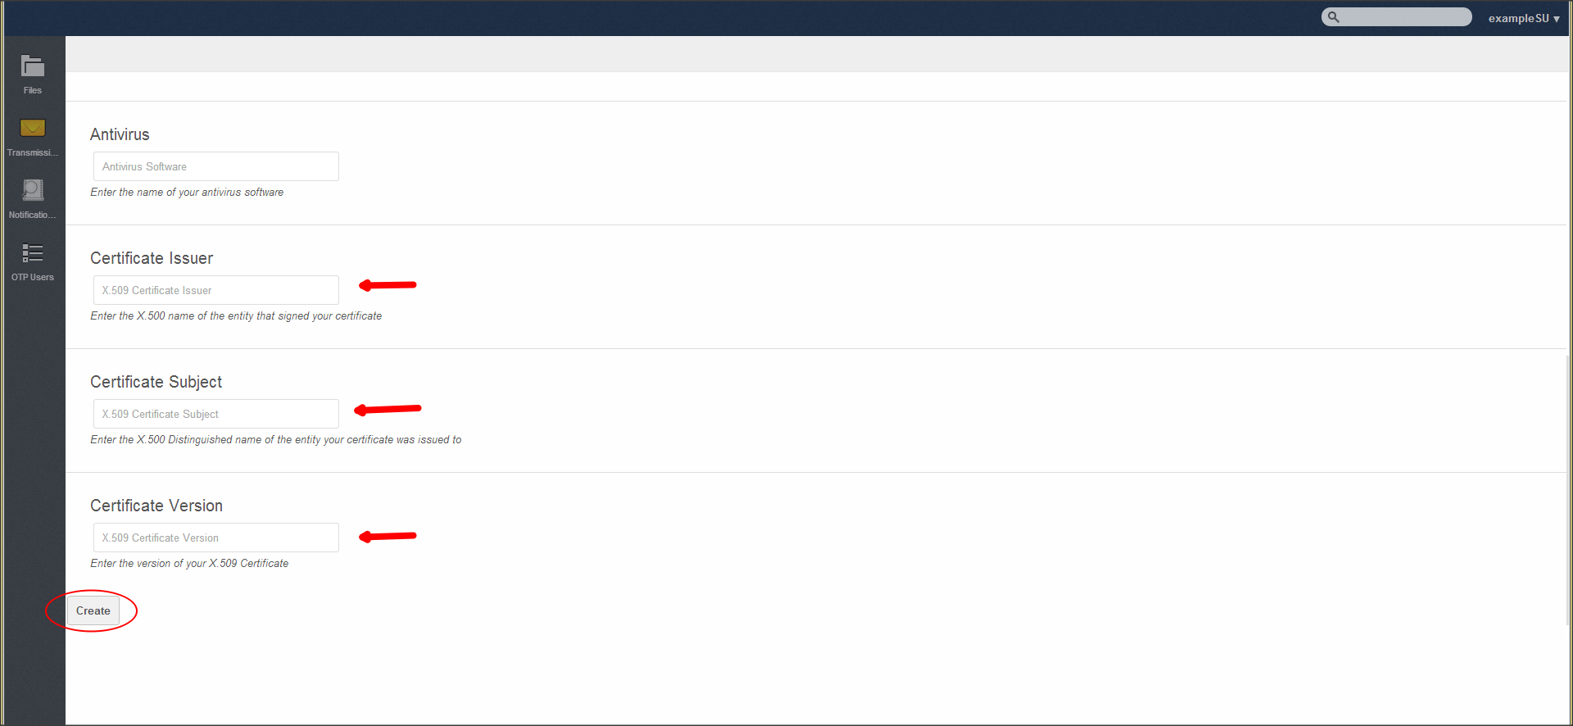
Step 27-28: Provide information on the HCTA(scroll down to create)

Slide 33
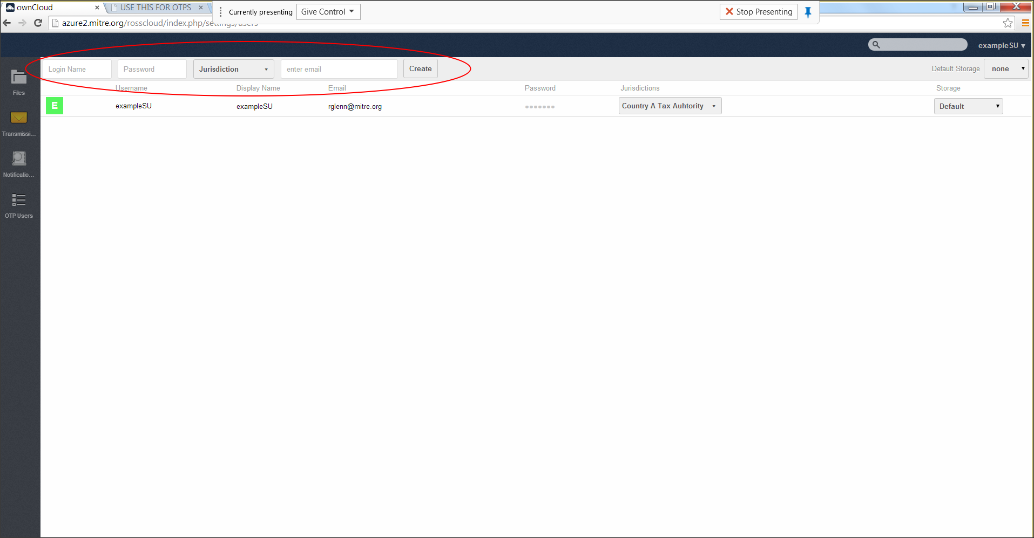
Step 31: create additional AU

Slide 34
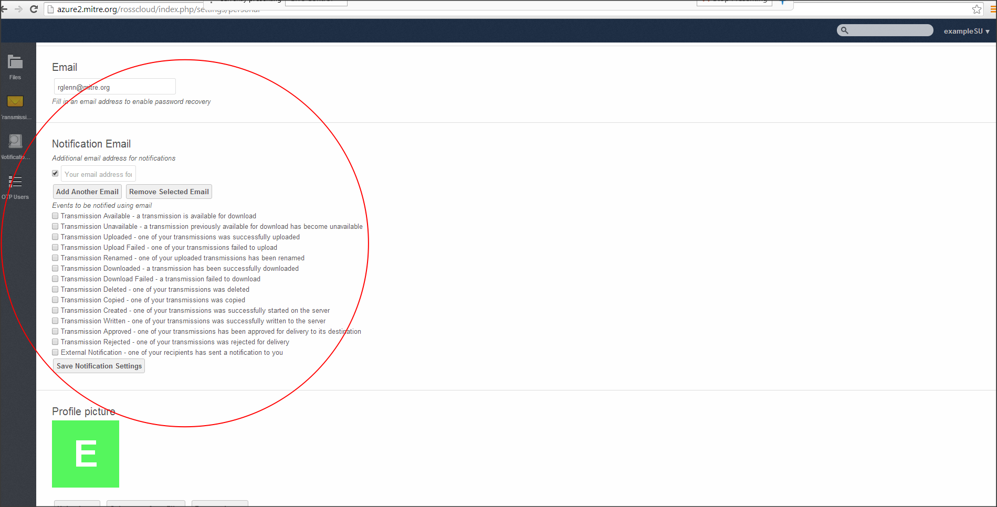
Step 33: Configure Alerts

